Slide 1

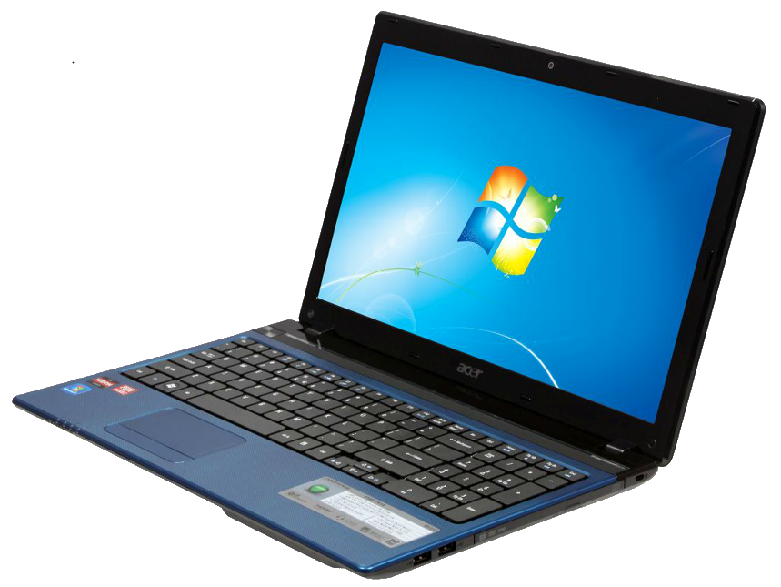

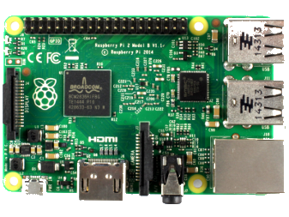
Windows 10 IoT
+
=
Catapult Systems
@CodeToLive

Slide 2
Agenda
Preparing your laptop for IoT Development
Installing Windows 10 IoT on a Raspberry Pi
Configuring your IoT device
Default Config Screen
Web Page Config
Powershell
SSH
Online Projects
Review Motion Detector Application

Slide 3
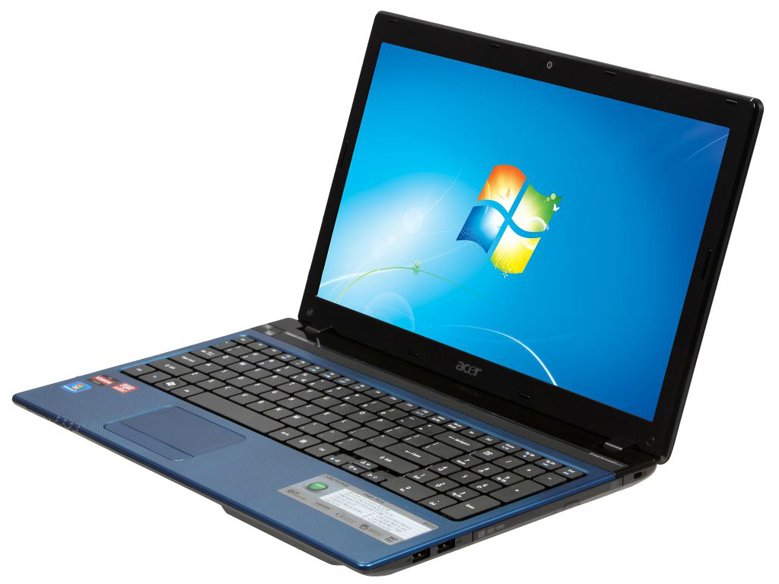
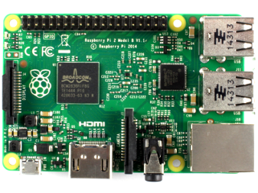
Preparing Laptop and Device
+
https://dev.windows.com/en-us/iot
Notes:
Click Link
Click Get Started
Review Different types on Devices
Choose Rpi
Review steps to configure laptop & Device
Boot Rpi
Show default config app
Switch back to desktop and show IoT Watcher
Show Device Web Page
Show Device Shares
Discuss Powershell and SSH Connection (Show commands)
Poweshell (https://ms-iot.github.io/content/en-US/win10/samples/PowerShell.htm)
SSH (https://ms-iot.github.io/content/en-US/win10/samples/SSH.htm)

Slide 4
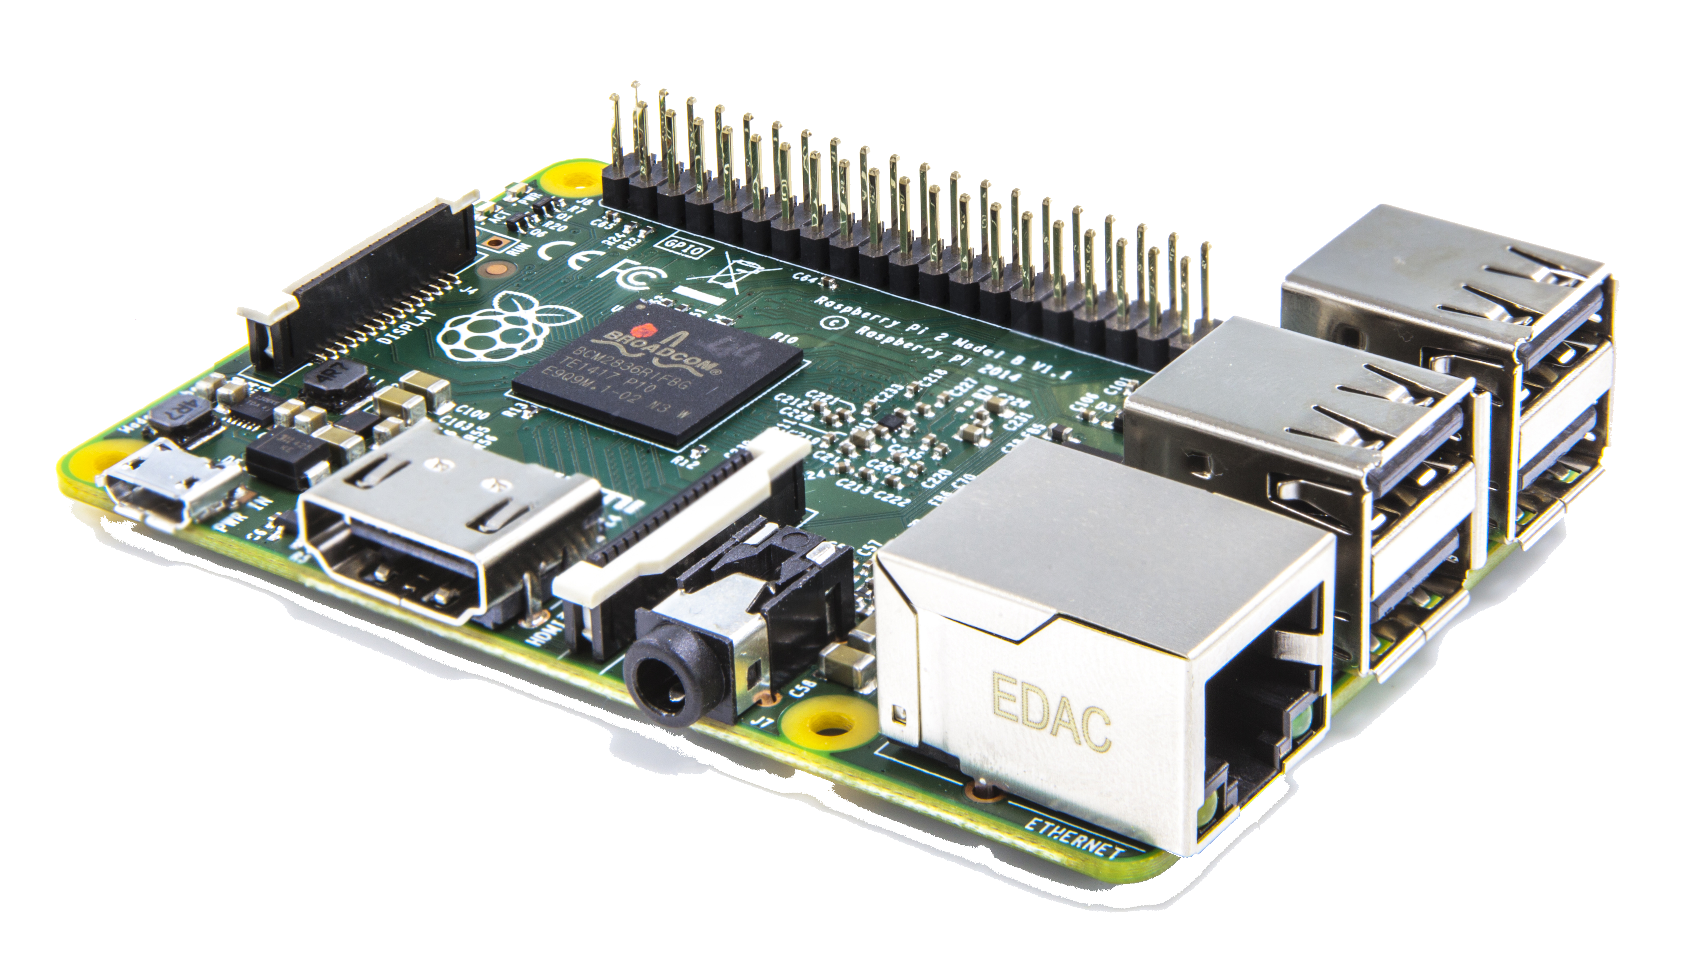
Raspberry Pi Specs
A 900MHz quad-core ARM Cortex-A7 CPU
1GB RAM
4 USB ports
40 GPIO pins
Full HDMI port
Ethernet port
3.5mm audio jack & composite video
Camera interface (CSI)
Display interface (DSI)
Micro SD card slot

Slide 5
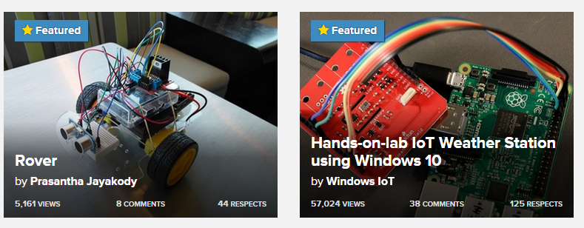
Getting Started with project walkthroughs
https://microsoft.hackster.io/en-US

Slide 6
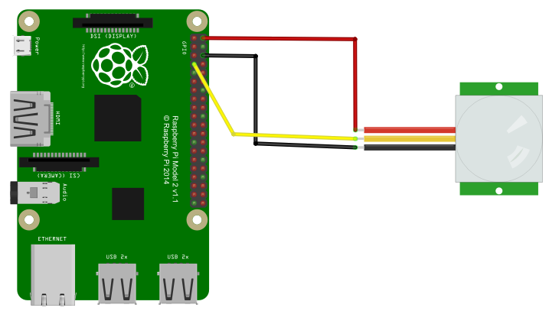
Motion Detector Hardware

Slide 7
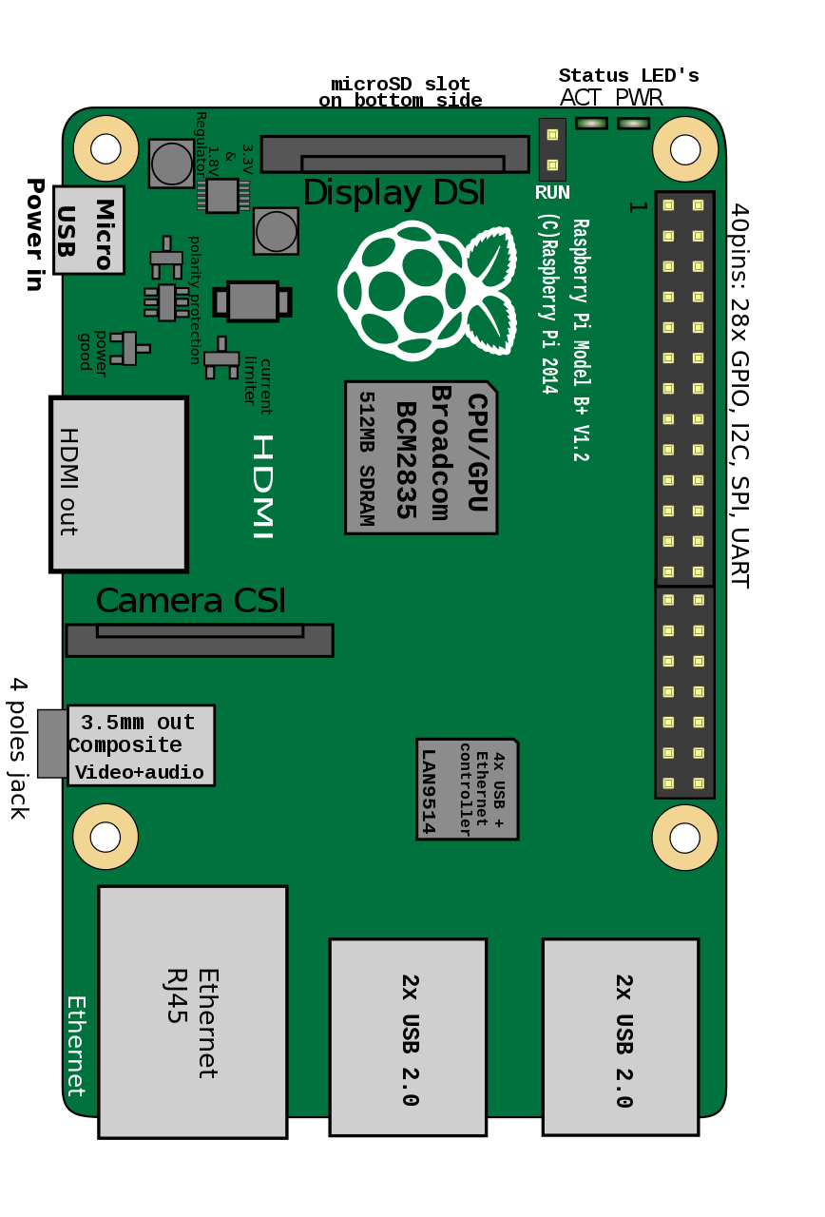
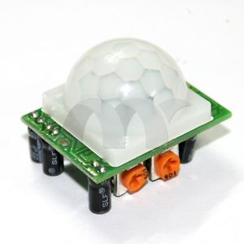
IoT Motion Detector
DEMO

Slide 8
Resources
Start
https://dev.windows.com/en-us/iot
Tutorials
https://microsoft.hackster.io/en-US
SSH
https://ms-iot.github.io/content/en-US/win10/samples/SSH.htm
PowerShell
https://ms-iot.github.io/content/en-US/win10/samples/PowerShell.htm

